Slide 1

Report Video
Group 8

Slide 2
Hi

Slide 3
Everyone

Slide 4

Nice to meet U

Slide 5
Next, U will see

Slide 6
An unforgettable

Slide 7
Game Introduction

Slide 8
Cautious!

Slide 9
Please don't blink

Slide 10
Do not blink

Slide 11
Countdown for 3 seconds

Slide 12
3

Slide 13
2

Slide 14
1

Slide 15
let's go

Slide 16


We are

Slide 17
Group 8

Slide 18
Handsome

Slide 19
Talented

Slide 20
Intelligent

Slide 21
Group 8

Slide 22


Next, I will carefully introduce our members

Slide 23
First of all

Slide 24
Zewen Liang

Slide 25
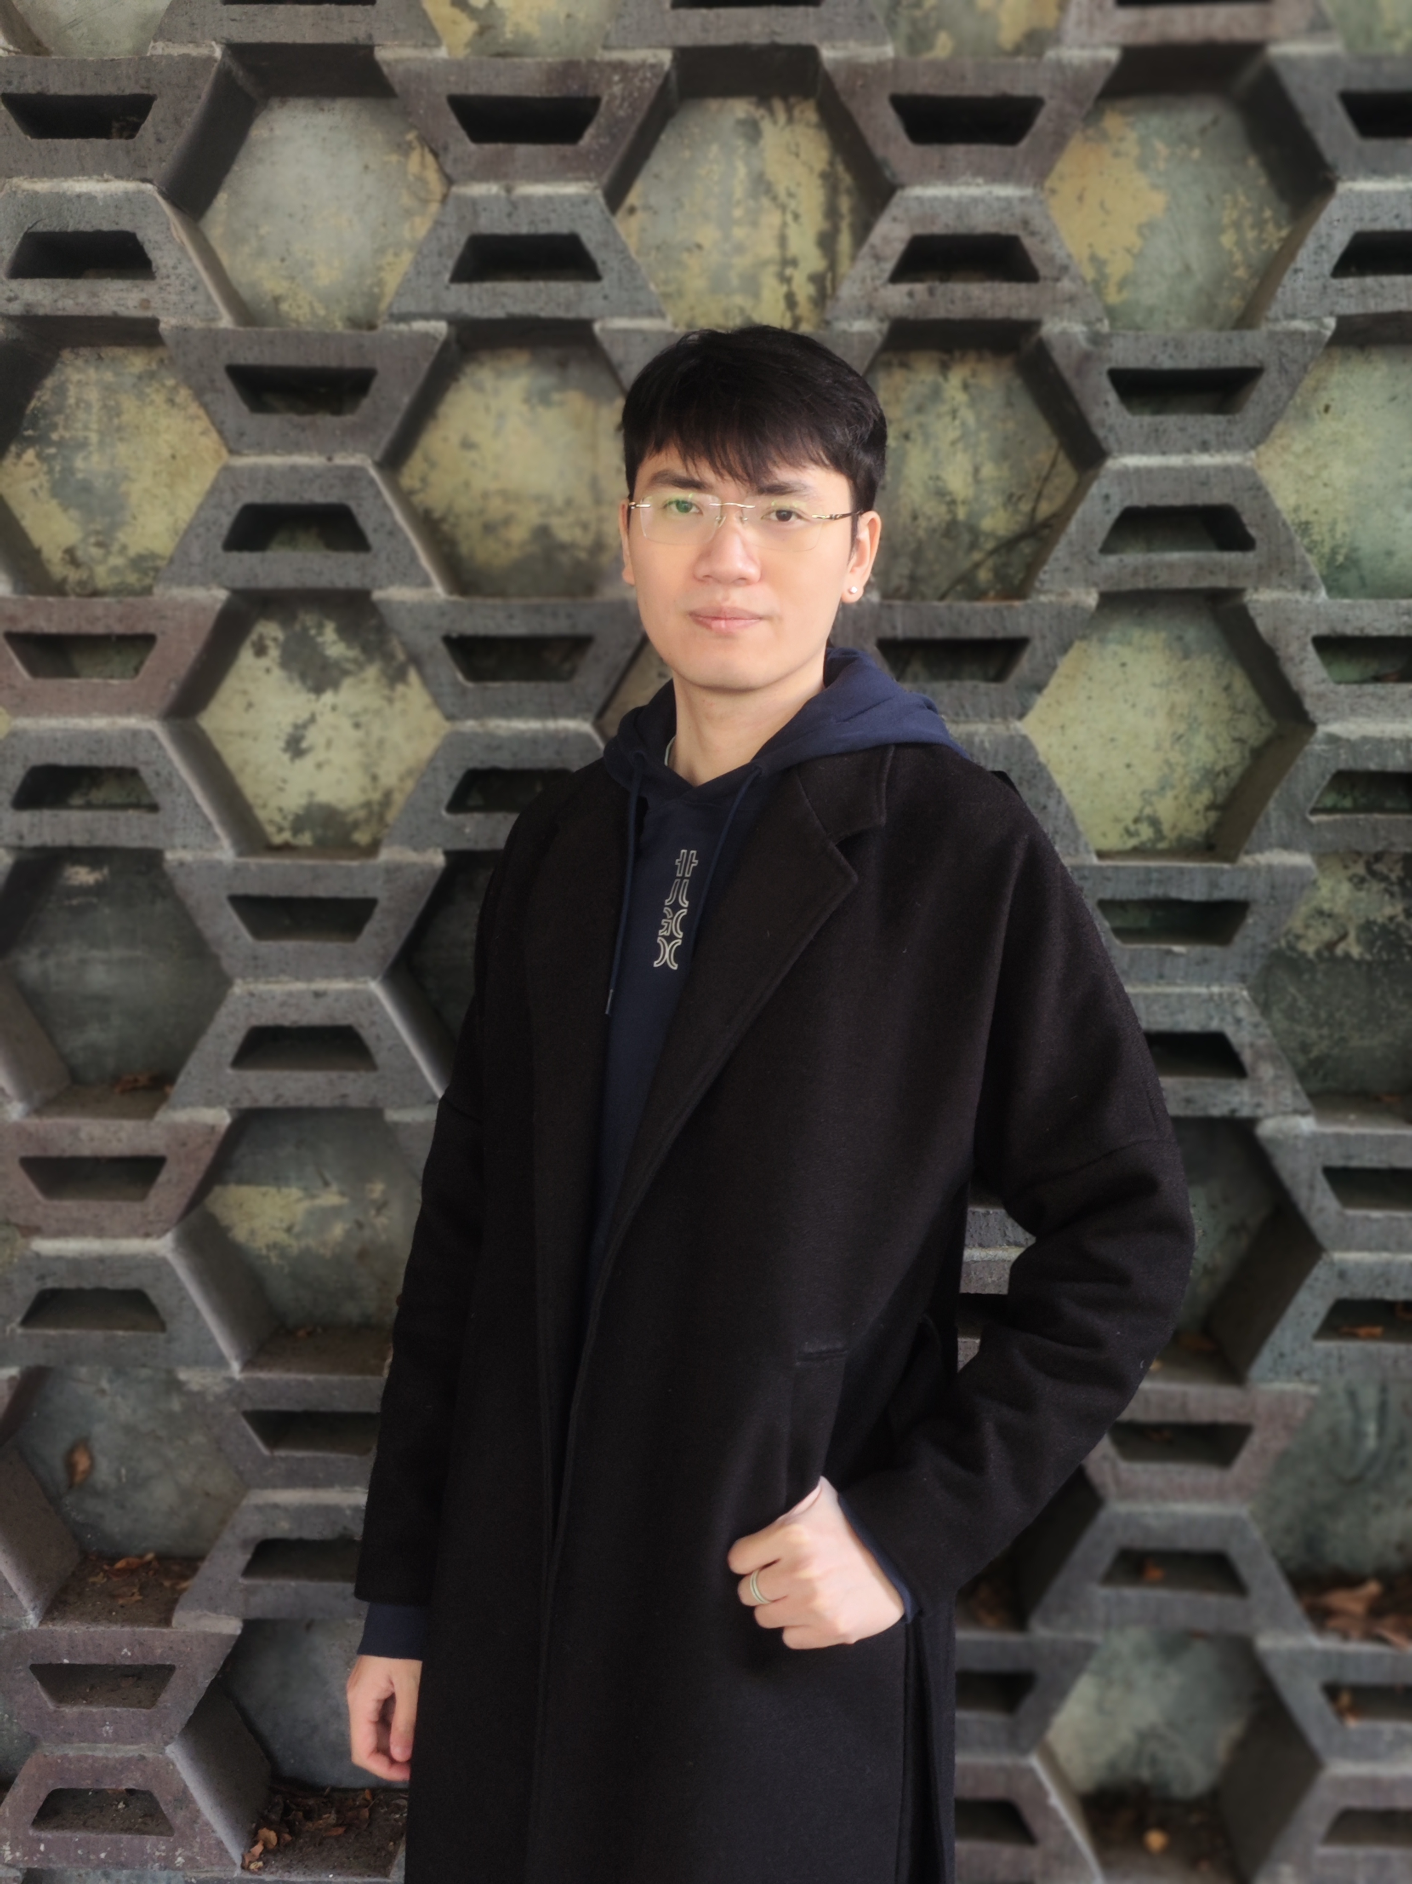

Slide 26
Developer

Slide 27
A synonym for genius

Slide 28
Yunhao Zhou

Slide 29
Next

Slide 30
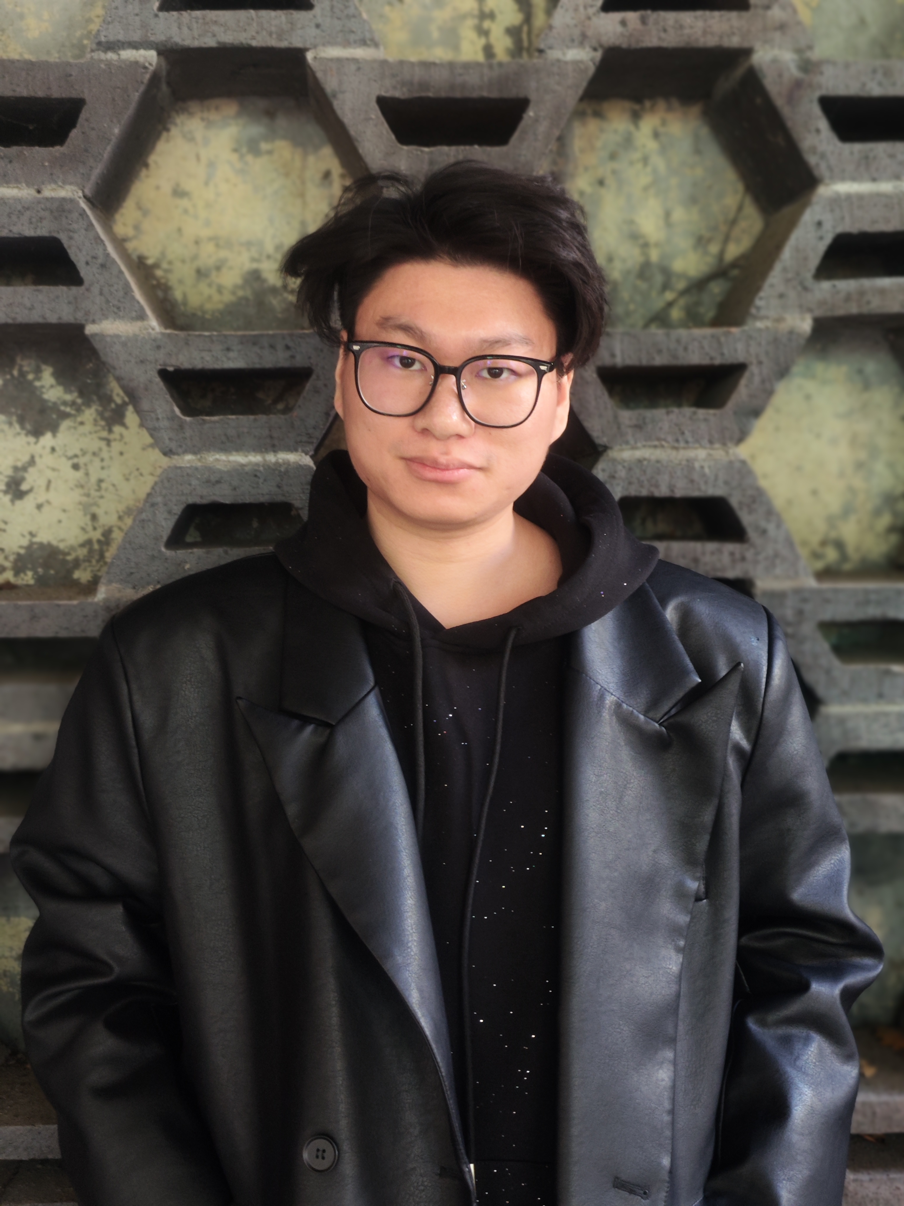

Slide 31
Visual Designer

Slide 32
An excellent painter

Slide 33
And then

Slide 34
Zhi Zhao

Slide 35
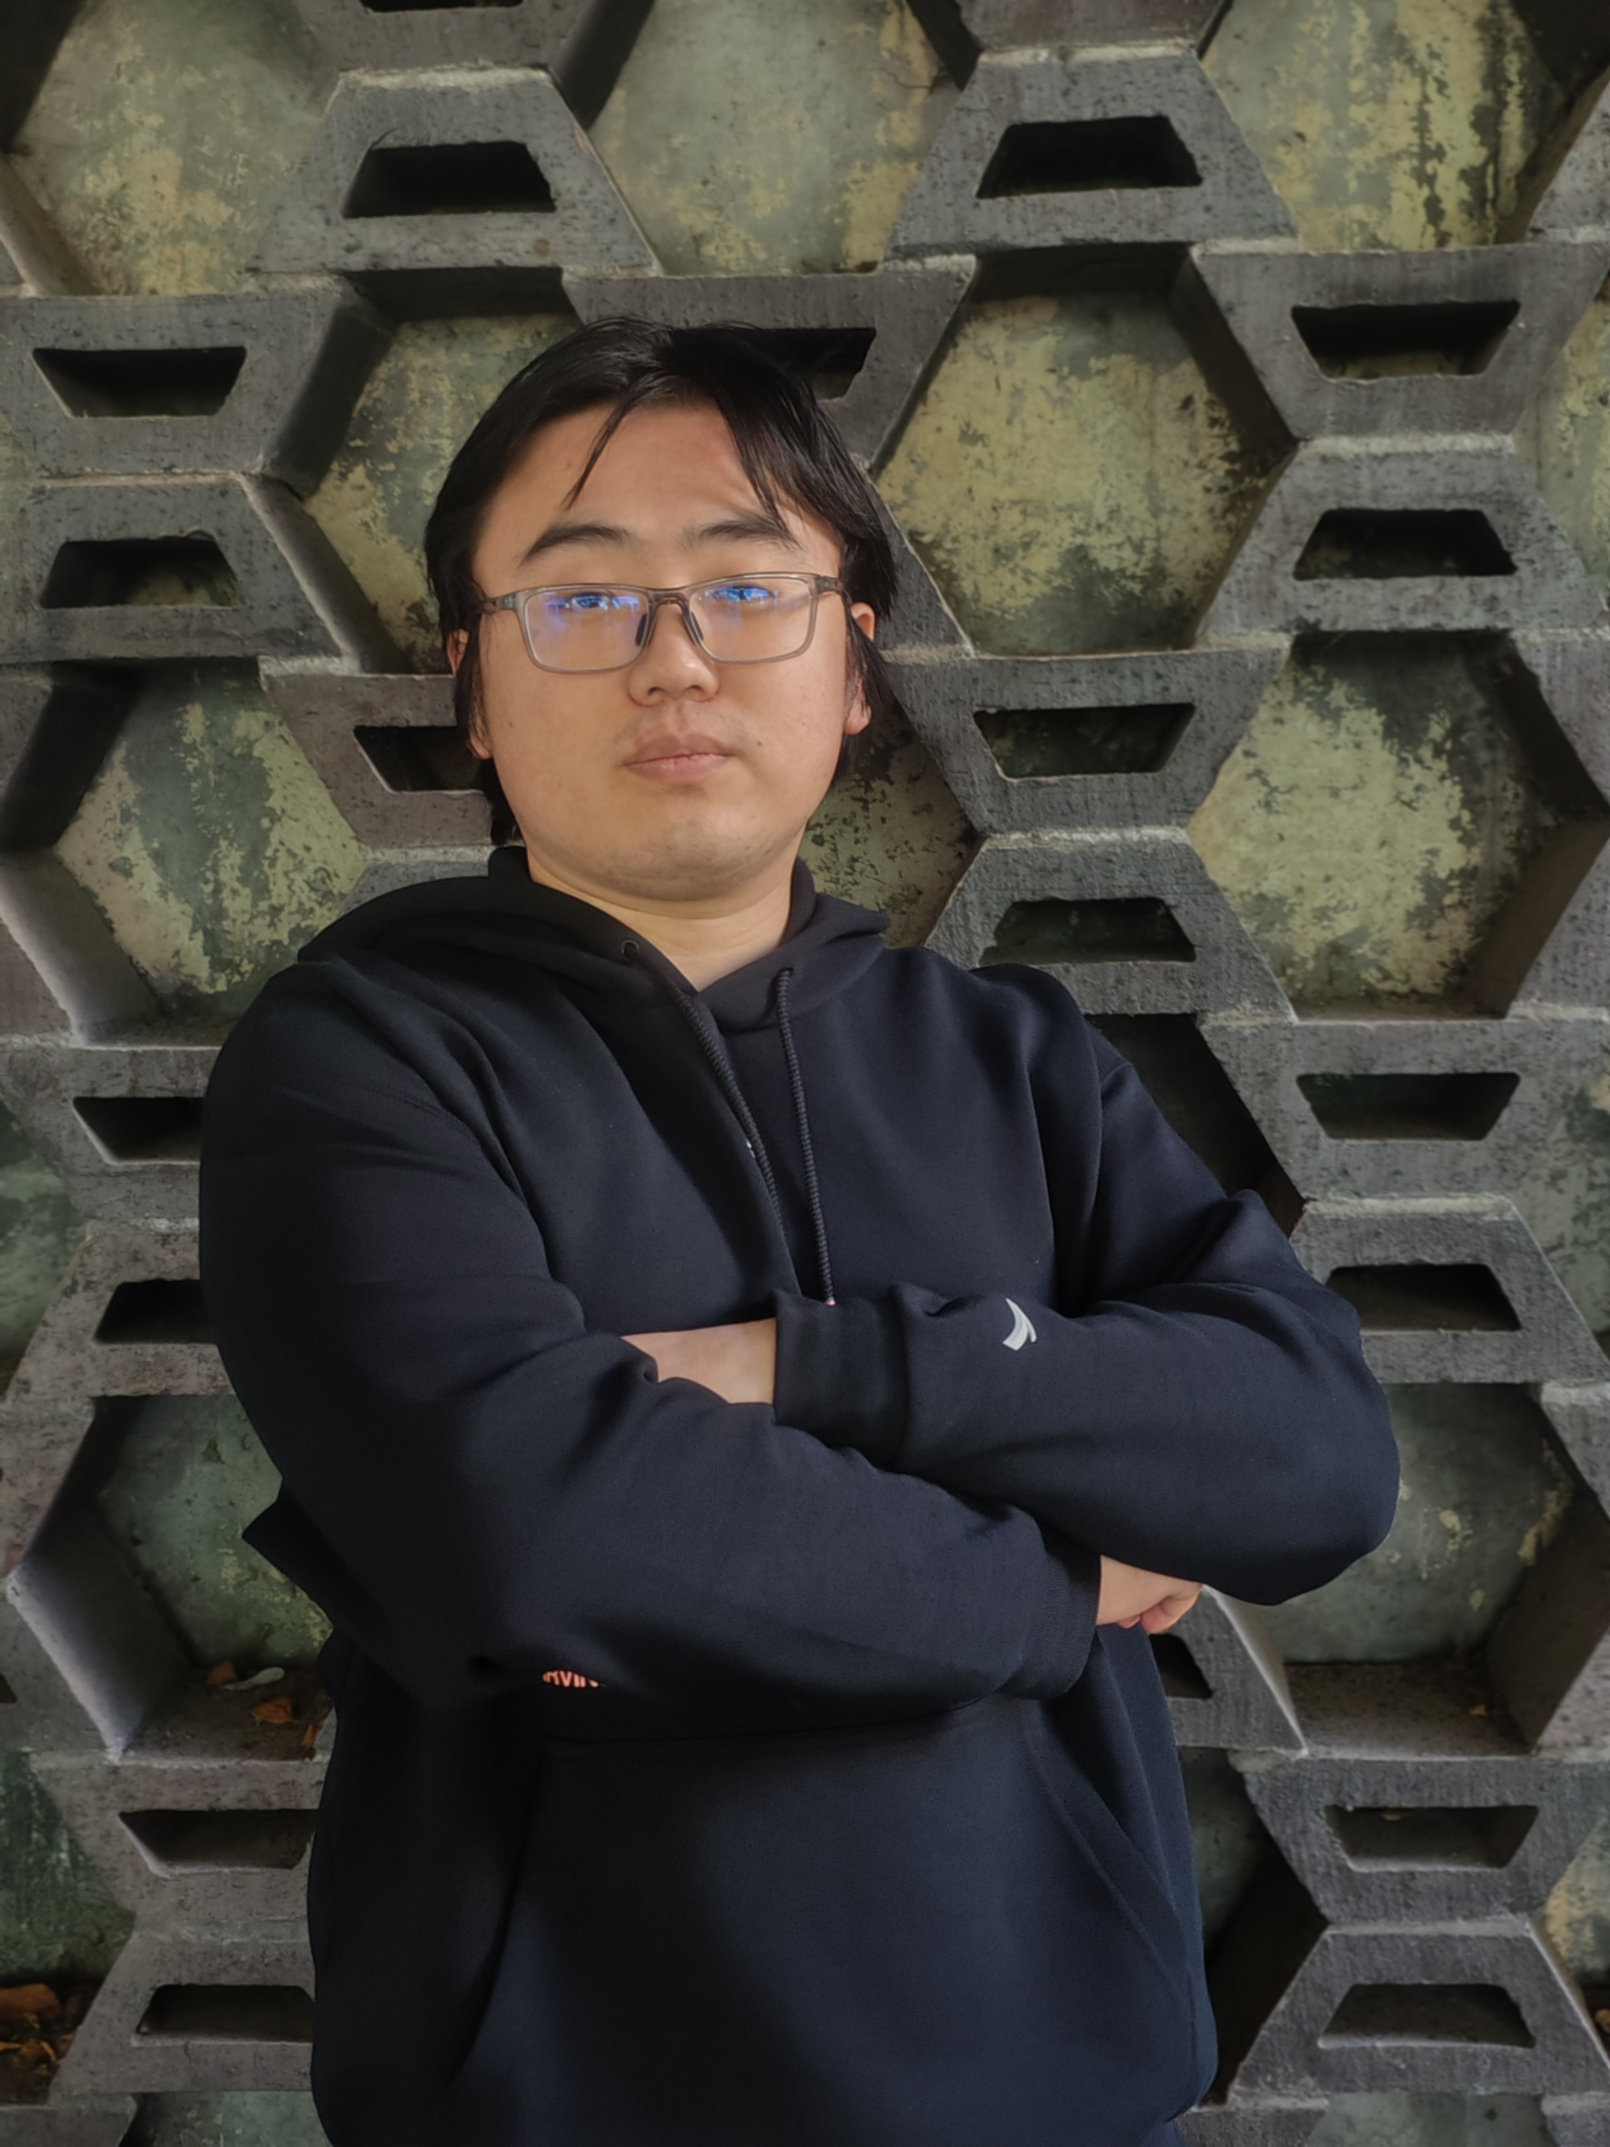

Slide 36
Developer

Slide 37
A thoughtful programmer

Slide 38
Besides

Slide 39
Yuying Zhang

Slide 40
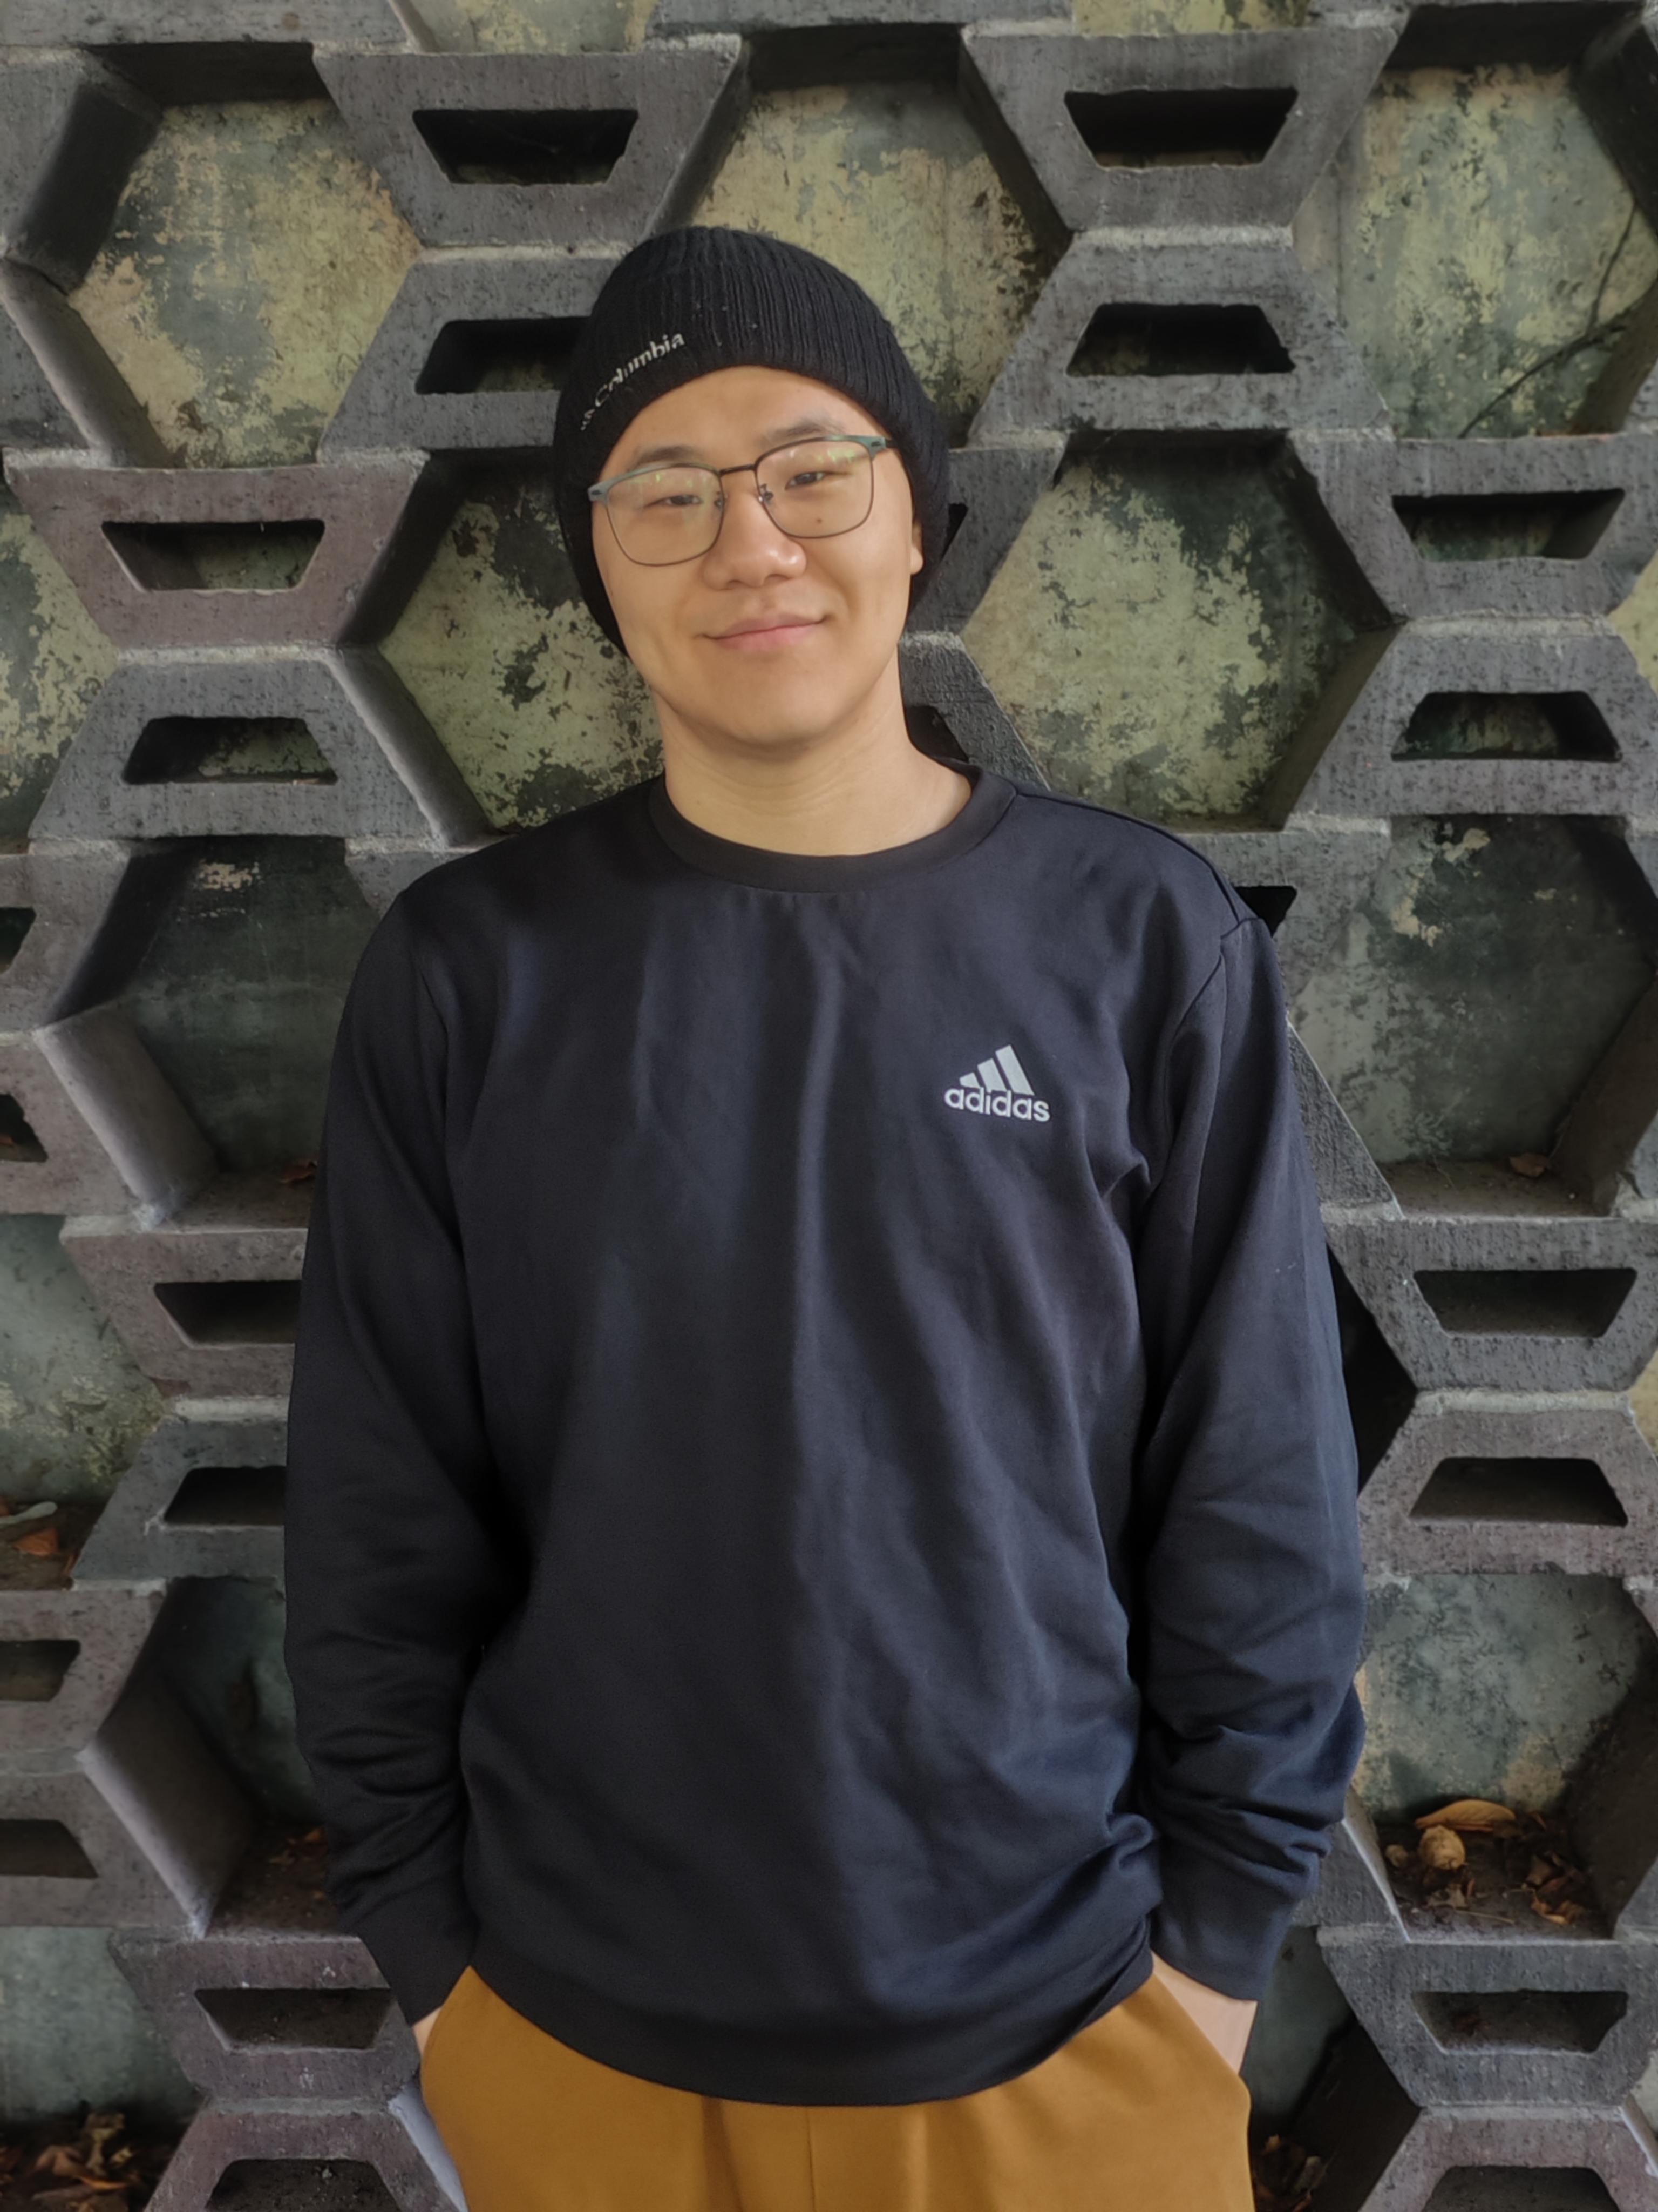

Slide 41
Copywriter

Slide 42
A diligent assistant

Slide 43
Finally

Slide 44
Kaijie Xu

Slide 45
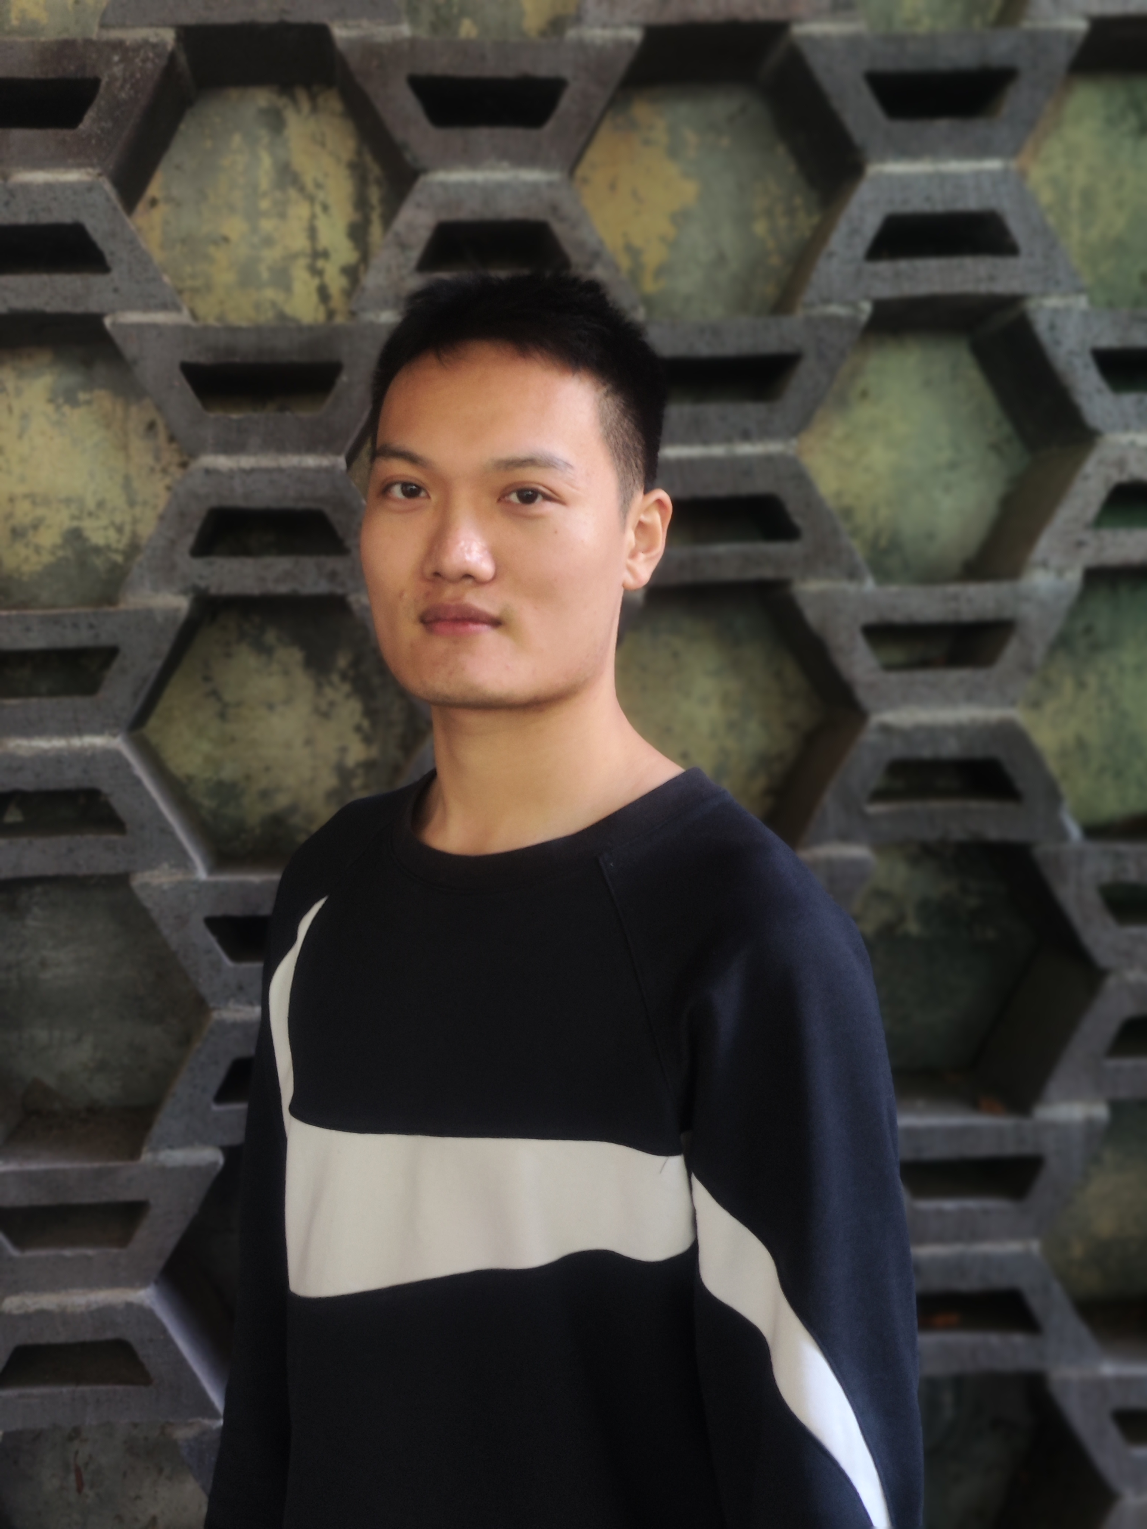

Slide 46
Project Manager

Slide 47
A charismatic dispatcher

Slide 48
Thank you for watching

